Slide 1
Ch.1 Terahertz Time-Domain Spectrometer
Lee Jong Geon

Slide 2
Contents
Pulsed Terahertz Time-Domain Spectrometers
Continuous-Wave Terahertz Time-Domain Spectrometer and Microwave Photonics
Time-Domain Spectrometer Configurations

Slide 3
Pulsed Terahertz
Time-Domain Spectrometers

Slide 4
1.1 Principles of Operation

Slide 5
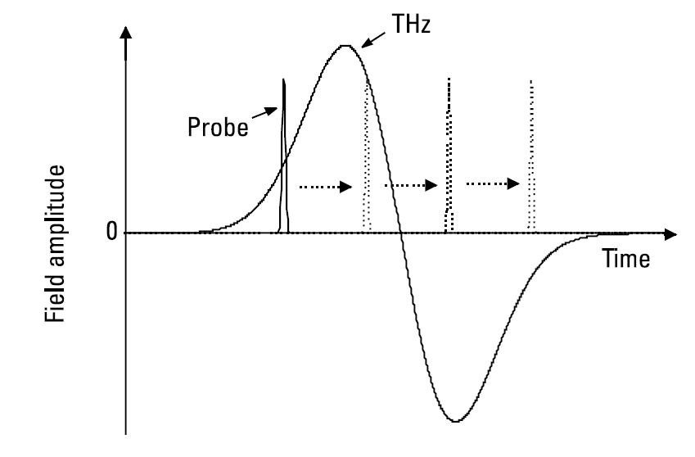

1.1 Principles of Operation
$$Signal\left(t_{0}\right) ∝ \int_{−∞}^{∞}{I_{probe}\left(t−t_{0}\right)E_{THz}\left(t\right)dt}$$

Slide 6
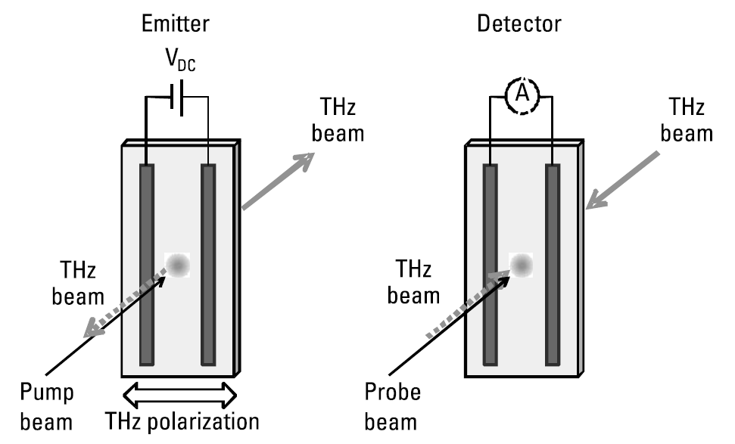
1.2 Photoconductive Emitters and Detectors

Slide 7
1.3 Optical Rectification

Slide 8
1.4 Electro-Optic Detection

Slide 9
1.5 Terahertz Air-Based Coherent Detection

Slide 10
1.6 Cherenkov Emitters and Detectors

Slide 11
Continuous-Wave Terahertz
Time-Domain Spectrometer
and Microwave Photonics

Slide 12
2.1 Principles of Operation

Slide 13
2.2 Types of Continuous-Wave Terahertz Emitters and Detectors

Slide 14
Time-Domain Spectrometer
Configurations

Slide 15
3.1 Transmission

Slide 16
3.2 Reflection

Slide 17
3.3Attenuated Total Reflection

Slide 18
3.4 Asynchronous Optical Sampling

Slide 19
3.5 Substrate Lenses

Slide 20
References

